Slide 1
U20ITT511- Data Warehousing and Data Mining III Year / V Semester R2020

Slide 2
Course Outcomes
CO1 - Describe a data warehouse (K2)
CO2 - Apply pre-processing techniques (K3)
CO3 - Interpret correlation based frequent patterns in large data sets (K2)
CO4 - Compare and contrast the various classifiers (K2)
CO5 - Apply data mining techniques and methods to large data sets (K3)

Slide 3
UNIT IV
UNIT IV –CLASSIFICATION
Classification: Basic concepts
Decision Tree Induction
Bayes Classification Methods
Rule Based Classification
Model evaluation and selection
Techniques to improve classification accuracy
Support Vector Machines
Classification using frequent patterns
Other Classification Methods

Slide 4
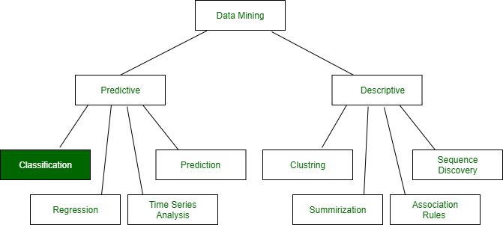
Classification: Basic concepts
Data Mining: Data mining in general terms means mining or digging deep into data that is in different forms to gain patterns, and to gain knowledge on that pattern.
In the process of data mining, large data sets are first sorted, then patterns are identified and relationships are established to perform data analysis and solve problems.

Slide 5
Classification: It is a data analysis task, i.e. the process of finding a model that describes and distinguishes data classes and concepts. Classification is the problem of identifying to which of a set of categories (subpopulations), a new observation belongs to, on the basis of a training set of data containing observations and whose categories membership is known.
Example: Before starting any project, we need to check its feasibility. In this case, a classifier is required to predict class labels such as ‘Safe’ and ‘Risky’ for adopting the Project and to further approve it. It is a two-step process such as :

Slide 6
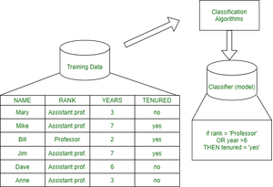
Learning Step (Training Phase): Construction of Classification Model Different Algorithms are used to build a classifier by making the model learn using the training set available. The model has to be trained for the prediction of accurate results.

Slide 7
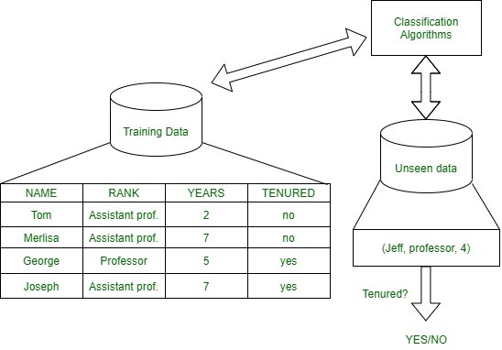
Classification Step: Model used to predict class labels and testing the constructed model on test data and hence estimate the accuracy of the classification rules.

Slide 8
Training and Testing:
Suppose there is a person who is sitting under a fan and the fan starts falling on him, he should get aside in order not to get hurt. So, this is his training part to move away. While Testing if the person sees any heavy object coming towards him or falling on him and moves aside then the system is tested positively and if the person does not move aside then the system is negatively tested. Same is the case with the data, it should be trained in order to get the accurate and best results.
There are certain data types associated with data mining that actually tells us the format of the file (whether it is in text format or in numerical format). Attributes – Represents different features of an object. Different types of attributes are:

Slide 9
Binary: Possesses only two values i.e. True or False Example: Suppose there is a survey evaluating some products. We need to check whether it’s useful or not. So, the Customer has to answer it in Yes or No. Product usefulness: Yes / No
Symmetric: Both values are equally important in all aspects
Asymmetric: When both the values may not be important.
Nominal: When more than two outcomes are possible. It is in Alphabet form rather than being in Integer form. Example: One needs to choose some material but of different colors. So, the color might be Yellow, Green, Black, Red. Different Colors: Red, Green, Black, Yellow
Ordinal: Values that must have some meaningful order. Example: Suppose there are grade sheets of few students which might contain different grades as per their performance such as A, B, C, D Grades: A, B, C, D
Continuous: May have an infinite number of values, it is in float type Example: Measuring the weight of few Students in a sequence or orderly manner i.e. 50, 51, 52, 53 Weight: 50, 51, 52, 53
Discrete: Finite number of values. Example: Marks of a Student in a few subjects: 65, 70, 75, 80, 90 Marks: 65, 70, 75, 80, 90

Slide 10
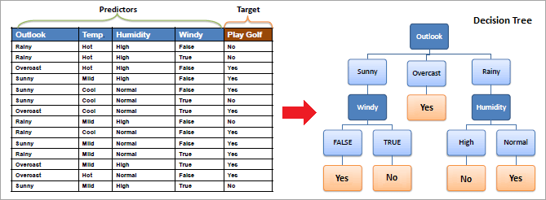

Slide 11
DECISION TREE INDUCTION
Decision Tree Mining is a type of data mining technique that is used to build Classification Models. It builds classification models in the form of a tree-like structure, just like its name. This type of mining belongs to supervised class learning.
In supervised learning, the target result is already known. Decision trees can be used for both categorical and numerical data. The categorical data represent gender, marital status, etc. while the numerical data represent age, temperature, etc.
An example of a decision tree with the dataset is shown below.

Slide 12
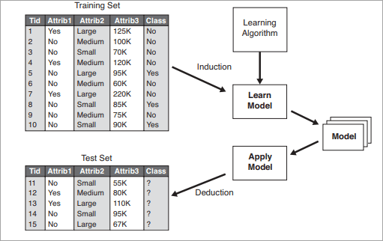
A two-step process is followed, to build a classification model.
In the first step i.e. learning: A classification model based on training data is built.
In the second step i.e. Classification, the accuracy of the model is checked and then the model is used to classify new data. The class labels presented here are in the form of discrete values such as “yes” or “no”, “safe” or “risky”.
The general approach for building classification models is given below:

Slide 13
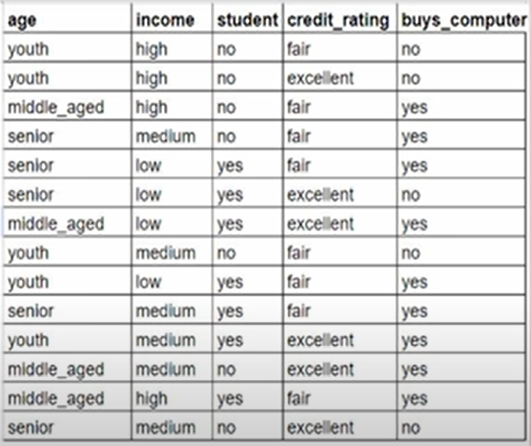

Slide 14
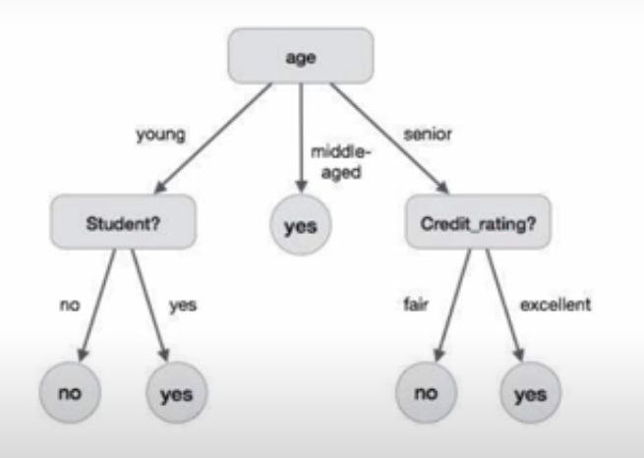

Slide 16
Classifiers Of Machine Learning:
Decision Trees
Bayesian Classifiers
Neural Networks
K-Nearest Neighbour
Support Vector Machines
Linear Regression
Logistic Regression
Real–Life Examples :
Market Basket Analysis: It is a modeling technique that has been associated with frequent transactions of buying some combination of items. Example: Amazon and many other Retailers use this technique. While viewing some products, certain suggestions for the commodities are shown that some people have bought in the past.
Weather Forecasting: Changing Patterns in weather conditions needs to be observed based on parameters such as temperature, humidity, wind direction. This keen observation also requires the use of previous records in order to predict it accurately.

Slide 17
What Is The Use Of A Decision Tree?
Decision Tree is used to build classification and regression models. It is used to create data models that will predict class labels or values for the decision-making process. The models are built from the training dataset fed to the system (supervised learning).
Using a decision tree, we can visualize the decisions that make it easy to understand and thus it is a popular data mining technique.
Classification Analysis
Data Classification is a form of analysis which builds a model that describes important class variables. For example, a model built to categorize bank loan applications as safe or risky. Classification methods are used in machine learning, and pattern recognition.
Application of classification includes fraud detection, medical diagnosis, target marketing, etc. The output of the classification problem is taken as “Mode” of all observed values of the terminal node.

Slide 18
Classifiers can be categorized into two major types: Discriminative: It is a very basic classifier and determines just one class for each row of data. It tries to model just by depending on the observed data, depends heavily on the quality of data rather than on distributions. Example: Logistic Regression Acceptance of a student at a University (Test and Grades need to be considered) Suppose there are few students and the Result of them are as follows :
Generative: It models the distribution of individual classes and tries to learn the model that generates the data behind the scenes by estimating assumptions and distributions of the model. Used to predict the unseen data.
Example: Naive Bayes Classifier
Detecting Spam emails by looking at the previous data. Suppose 100 emails and that too divided in 1:4 i.e. Class A: 25%(Spam emails) and Class B: 75%(Non-Spam emails). Now if a user wants to check that if an email contains the word cheap, then that may be termed as Spam. It seems to be that in Class A(i.e. in 25% of data), 20 out of 25 emails are spam and rest not. And in Class B(i.e. in 75% of data), 70 out of 75 emails are not spam and rest are spam. So, if the email contains the word cheap, what is the probability of it being spam ?? (= 80%)

Slide 19
Regression Analysis
Regression analysis is used for the prediction of numeric attributes.
Numeric attributes are also called continuous values. A model built to predict the continuous values instead of class labels is called the regression model. The output of regression analysis is the “Mean” of all observed values of the node.
How Does A Decision Tree Work?
A decision tree is a supervised learning algorithm that works for both discrete and continuous variables. It splits the dataset into subsets on the basis of the most significant attribute in the dataset. How the decision tree identifies this attribute and how this splitting is done is decided by the algorithms.
The most significant predictor is designated as the root node, splitting is done to form sub-nodes called decision nodes, and the nodes which do not split further are terminal or leaf nodes.
In the decision tree, the dataset is divided into homogeneous and non-overlapping regions. It follows a top-down approach as the top region presents all the observations at a single place which splits into two or more branches that further split. This approach is also called a greedy approach as it only considers the current node between the worked on without focusing on the future nodes.

Slide 20
The decision tree algorithms will continue running until a stop criteria such as the minimum number of observations etc. is reached.
Once a decision tree is built, many nodes may represent outliers or noisy data. Tree pruning method is applied to remove unwanted data. This, in turn, improves the accuracy of the classification model.
To find the accuracy of the model, a test set consisting of test tuples and class labels is used. The percentages of the test set tuples are correctly classified by the model to identify the accuracy of the model. If the model is found to be accurate then it is used to classify the data tuples for which the class labels are not known.
Some of the decision tree algorithms include Hunt’s Algorithm, ID3, CD4.5, and CART.

Slide 21
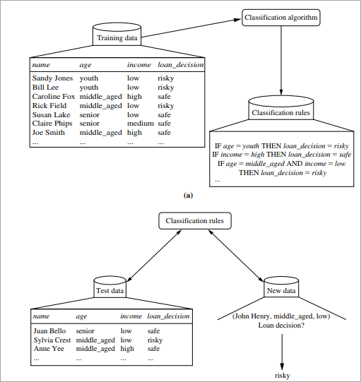
Example of Creating a Decision Tree
#1) Learning Step: The training data is fed into the system to be analyzed by a classification algorithm. In this example, the class label is the attribute i.e. “loan decision”. The model built from this training data is represented in the form of decision rules.
#2) Classification: Test dataset are fed to the model to check the accuracy of the classification rule. If the model gives acceptable results then it is applied to a new dataset with unknown class variables.

Slide 22
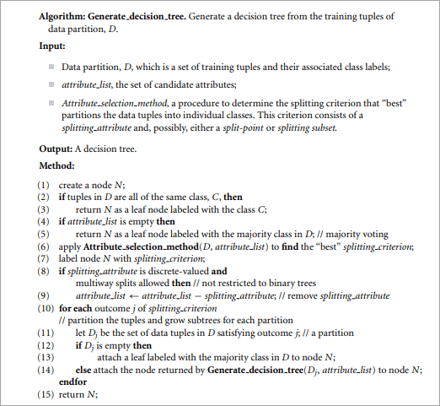
Decision Tree Induction Algorithm

Slide 23
Decision Tree Induction
Decision tree induction is the method of learning the decision trees from the training set. The training set consists of attributes and class labels. Applications of decision tree induction include astronomy, financial analysis, medical diagnosis, manufacturing, and production.
A decision tree is a flowchart tree-like structure that is made from training set tuples. The dataset is broken down into smaller subsets and is present in the form of nodes of a tree. The tree structure has a root node, internal nodes or decision nodes, leaf node, and branches.
The root node is the topmost node. It represents the best attribute selected for classification. Internal nodes of the decision nodes represent a test of an attribute of the dataset leaf node or terminal node which represents the classification or decision label. The branches show the outcome of the test performed.
Some decision trees only have binary nodes, that means exactly two branches of a node, while some decision trees are non-binary

Slide 24


The most popular methods of selecting the attribute are information gain, Gini index.
#1) Information Gain
This method is the main method that is used to build decision trees. It reduces the information that is required to classify the tuples. It reduces the number of tests that are needed to classify the given tuple. The attribute with the highest information gain is selected.
The original information needed for classification of a tuple in dataset D is given by:
Where p is the probability that the tuple belongs to class C. The information is encoded in bits, therefore, log to the base 2 is used. E(s) represents the average amount of information required to find out the class label of dataset D. This information gain is also called Entropy.
The information required for exact classification after portioning is given by the formula:

Slide 25

Where P (c) is the weight of partition. This information represents the information needed to classify the dataset D on portioning by X.
Information gain is the difference between the original and expected information that is required to classify the tuples of dataset D.
Gain is the reduction of information that is required by knowing the value of X. The attribute with the highest information gain is chosen as “best”.

Slide 26



#2) Gain Ratio
Information gain might sometimes result in portioning useless for classification. However, the Gain ratio splits the training data set into partitions and considers the number of tuples of the outcome with respect to the total tuples. The attribute with the max gain ratio is used as a splitting attribute.
#3) Gini Index
Gini Index is calculated for binary variables only. It measures the impurity in training tuples of dataset D, as
P is the probability that tuple belongs to class C. The Gini index that is calculated for binary split dataset D by attribute A is given by:
Where n is the nth partition of the dataset D.
The reduction in impurity is given by the difference of the Gini index of the original dataset D and Gini index after partition by attribute A.
The maximum reduction in impurity or max Gini index is selected as the best attribute for splitting.

Slide 27
There are two ways of pruning the tree:
#1) Prepruning: In this approach, the construction of the decision tree is stopped early. It means it is decided not to further partition the branches. The last node constructed becomes the leaf node and this leaf node may hold the most frequent class among the tuples.
The attribute selection measures are used to find out the weightage of the split. Threshold values are prescribed to decide which splits are regarded as useful. If the portioning of the node results in splitting by falling below threshold then the process is halted.
#2) Postpruning: This method removes the outlier branches from a fully grown tree. The unwanted branches are removed and replaced by a leaf node denoting the most frequent class label. This technique requires more computation than prepruning, however, it is more reliable.
The pruned trees are more precise and compact when compared to unpruned trees but they carry a disadvantage of replication and repetition.
Repetition occurs when the same attribute is tested again and again along a branch of a tree. Replication occurs when the duplicate subtrees are present within the tree. These issues can be solved by multivariate splits.

Slide 28
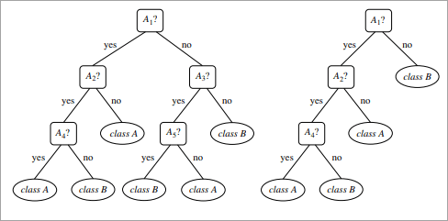
The Below image shows an unpruned and pruned tree.

Slide 29
Example of Decision Tree Algorithm
Constructing a Decision Tree
Let us take an example of the last 10 days weather dataset with attributes outlook, temperature, wind, and humidity. The outcome variable will be playing cricket or not. We will use the ID3 algorithm to build the decision tree.
Day | Outlook | Temperature | Humidity | Wind | Play cricket
1 | Sunny | Hot | High | Weak | No
2 | Sunny | Hot | High | Strong | No
3 | Overcast | Hot | High | Weak | Yes
4 | Rain | Mild | High | Weak | Yes
5 | Rain | Cool | Normal | Weak | Yes
6 | Rain | Cool | Normal | Strong | No
7 | Overcast | Cool | Normal | Strong | Yes
8 | Sunny | Mild | High | Weak | No
9 | Sunny | Cool | Normal | Weak | Yes
10 | Rain | Mild | Normal | Weak | Yes
11 | Sunny | Mild | Normal | Strong | Yes
12 | Overcast | Mild | High | Strong | Yes
13 | Overcast | Hot | Normal | Weak | Yes
14 | Rain | Mild | High | Strong | No

Slide 30
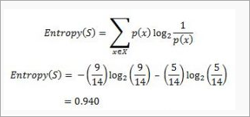
Step1: The first step will be to create a root node.
Step2: If all results are yes, then the leaf node “yes” will be returned else the leaf node “no” will be returned.
Step3: Find out the Entropy of all observations and entropy with attribute “x” that is E(S) and E(S, x).
Step4: Find out the information gain and select the attribute with high information gain.
Step5: Repeat the above steps until all attributes are covered.
Calculation of Entropy:
Yes No
9 5
If entropy is zero, it means that all members belong to the same class and if entropy is one then it means that half of the tuples belong to one class and one of them belong to other class. 0.94 means fair distribution.
Find the information gain attribute which gives maximum information gain.

Slide 31

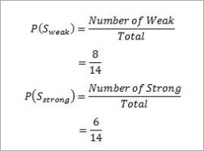

For Example “Wind”, it takes two values: Strong and Weak, therefore, x = {Strong, Weak}.
Find out H(x), P(x) for x =weak and x= strong. H(S) is already calculated above.
Weak= 8
Strong= 8
For “weak” wind, 6 of them say “Yes” to play cricket and 2 of them say “No”. So entropy will be:

Slide 32

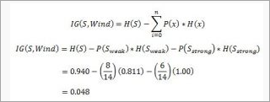
For “strong” wind, 3 said “No” to play cricket and 3 said “Yes”.
This shows perfect randomness as half items belong to one class and the remaining half belong to others.
Calculate the information gain,

Slide 33

Similarly the information gain for other attributes is:
The attribute outlook has the highest information gain of 0.246, thus it is chosen as root.
Overcast has 3 values: Sunny, Overcast and Rain. Overcast with play cricket is always “Yes”. So it ends up with a leaf node, “yes”. For the other values “Sunny” and “Rain”.
Table for Outlook as “Sunny” will be:
Temperature | Humidity | Wind | Golf
Hot | High | Weak | No
Hot | High | Strong | No
Mild | High | Weak | No
Cool | Normal | Weak | Yes
Mild | Normal | Strong | Yes

Slide 34


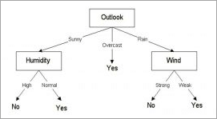
Entropy for “Outlook” “Sunny” is:
Information gain for attributes with respect to Sunny is:
The information gain for humidity is highest, therefore it is chosen as the next node. Similarly, Entropy is calculated for Rain. Wind gives the highest information gain.
The decision tree would look like below:

Slide 35
Advantages Of Decision Tree Classification
Enlisted below are the various merits of Decision Tree Classification:
Decision tree classification does not require any domain knowledge, hence, it is appropriate for the knowledge discovery process.
The representation of data in the form of the tree is easily understood by humans and it is intuitive.
It can handle multidimensional data.
It is a quick process with great accuracy.
Disadvantages Of Decision Tree Classification
Given below are the various demerits of Decision Tree Classification:
Sometimes decision trees become very complex and these are called overfitted trees.
The decision tree algorithm may not be an optimal solution.
The decision trees may return a biased solution if some class label dominates it.

Slide 36
Naive Bayes Classifiers
Naive Bayes classifiers are a collection of classification algorithms based on Bayes’ Theorem. It is not a single algorithm but a family of algorithms where all of them share a common principle, i.e. every pair of features being classified is independent of each other.

Slide 37
Consider a fictional dataset that describes the weather conditions for playing a game of golf. Given the weather conditions, each tuple classifies the conditions as fit(“Yes”) or unfit(“No”) for playing tennis.
Day | Outlook | Temperature | Humidity | Wind | Play tennis
1 | Sunny | Hot | High | Weak | No
2 | Sunny | Hot | High | Strong | No
3 | Overcast | Hot | High | Weak | Yes
4 | Rain | Mild | High | Weak | Yes
5 | Rain | Cool | Normal | Weak | Yes
6 | Rain | Cool | Normal | Strong | No
7 | Overcast | Cool | Normal | Strong | Yes
8 | Sunny | Mild | High | Weak | No
9 | Sunny | Cool | Normal | Weak | Yes
10 | Rain | Mild | Normal | Weak | Yes
11 | Sunny | Mild | Normal | Strong | Yes
12 | Overcast | Mild | High | Strong | Yes
13 | Overcast | Hot | Normal | Weak | Yes
14 | Rain | Mild | High | Strong | No

Slide 38
The dataset is divided into two parts, namely, feature matrix and the response vector.
Feature matrix contains all the vectors(rows) of dataset in which each vector consists of the value of dependent features. In above dataset, features are ‘Outlook’, ‘Temperature’, ‘Humidity’ and ‘Windy’.
Response vector contains the value of class variable(prediction or output) for each row of feature matrix. In above dataset, the class variable name is ‘Play tennis’.

Slide 39
Assumption:
The fundamental Naive Bayes assumption is that each feature makes an:
independent
equal
contribution to the outcome.
With relation to our dataset, this concept can be understood as:
We assume that no pair of features are dependent. For example, the temperature being ‘Hot’ has nothing to do with the humidity or the outlook being ‘Rainy’ has no effect on the winds. Hence, the features are assumed to be independent.
Secondly, each feature is given the same weight(or importance). For example, knowing only temperature and humidity alone can’t predict the outcome accurately. None of the attributes is irrelevant and assumed to be contributing equally to the outcome.

Slide 40

Now, before moving to the formula for Naive Bayes, it is important to know about Bayes’ theorem.
Bayes’ Theorem
Bayes’ Theorem finds the probability of an event occurring given the probability of another event that has already occurred. Bayes’ theorem is stated mathematically as the following equation:
where A and B are events and P(B) ? 0.
Basically, we are trying to find probability of event A, given the event B is true. Event B is also termed as evidence.
P(A) is the priori of A (the prior probability, i.e. Probability of event before evidence is seen). The evidence is an attribute value of an unknown instance(here, it is event B).
P(A|B) is a posteriori probability of B, i.e. probability of event after evidence is seen.

Slide 41
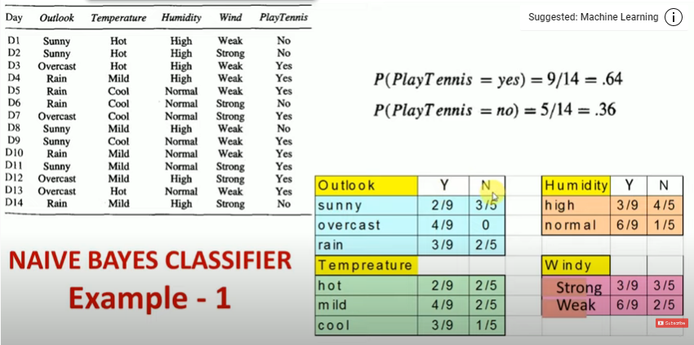
Example

Slide 42
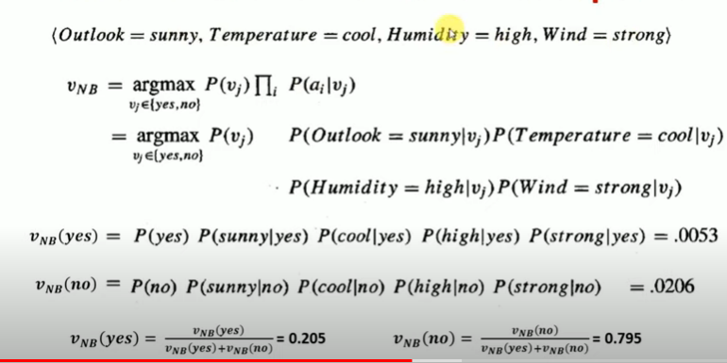

Slide 43
Please note that P(V_{j}) is also called class prior probability and P(a_{i} | V_{j}) is called conditional probability.
P(Yes/Today)=0.0053
P(No/Today)=0.0206
These numbers can be converted into a probability by making the sum equal to 1 (normalization):
Since P(No/Today)> P(Yes/Today)
So, prediction that tennis would be played is ‘No’.

Slide 44
Advantages Of Naive Bayes Classification
It is easy and fast to predict class of test data set. It also perform well in multi class prediction
When assumption of independence holds, a Naive Bayes classifier performs better compare to other models like logistic regression and you need less training data.
It perform well in case of categorical input variables compared to numerical variable(s). For numerical variable, normal distribution is assumed (bell curve, which is a strong assumption).
Disadvantages Of Naive Bayes Classification
If categorical variable has a category (in test data set), which was not observed in training data set, then model will assign a 0 (zero) probability and will be unable to make a prediction. This is often known as “Zero Frequency”. To solve this, we can use the smoothing technique. One of the simplest smoothing techniques is called Laplace estimation.
On the other side naive Bayes is also known as a bad estimator, so the probability outputs from predict_proba are not to be taken too seriously.
Another limitation of Naive Bayes is the assumption of independent predictors. In real life, it is almost impossible that we get a set of predictors which are completely independent.

Slide 45
Rule Based Classification
The term rule-based classification can be used to refer to any classification scheme that make use of IF-THEN rules for class prediction. Rule-based classification schemes typically consist of the following components:
Rule Induction Algorithm This refers to the process of extracting relevant IF-THEN rules from the data which can be done directly using sequential covering algorithms or indirectly from other data mining methods like decision tree building or association rule mining
Rule Ranking Measures This refers to some values that are used to measure the usefulness of a rule in providing accurate prediction. Rule ranking measures are often used in the rule induction algorithm to prune off unnecessary rules and improve efficiency. They are also used in the class prediction algorithm to give a ranking to the rules which will be then be utilized to predict the class of new cases.
Class Prediction Algorithm Given a new record.

Slide 46
IF-THEN Rules
Rule-based classifier makes use of a set of IF-THEN rules for classification. We can express a rule in the following from −
IF condition THEN conclusion
Let us consider a rule R1,
R1: IF age = youth AND student = yes THEN buy_computer = yes
Points to remember −
The IF part of the rule is called rule antecedent or precondition.
The THEN part of the rule is called rule consequent.
The antecedent part the condition consist of one or more attribute tests and these tests are logically ANDed.
The consequent part consists of class prediction.
Note − We can also write rule R1 as follows −
R1: (age = youth) ^ (student = yes))(buys computer = yes)
If the condition holds true for a given tuple, then the antecedent is satisfied.

Slide 47
Rule Extraction
Here we will learn how to build a rule-based classifier by extracting IF-THEN rules from a decision tree.
Points to remember −
To extract a rule from a decision tree −
One rule is created for each path from the root to the leaf node.
To form a rule antecedent, each splitting criterion is logically ANDed.
The leaf node holds the class prediction, forming the rule consequent
Rule Induction Using Sequential Covering Algorithm
Sequential Covering Algorithm can be used to extract IF-THEN rules form the training data. We do not require to generate a decision tree first. In this algorithm, each rule for a given class covers many of the tuples of that class.
Some of the sequential Covering Algorithms are AQ, CN2, and RIPPER. As per the general strategy the rules are learned one at a time. For each time rules are learned, a tuple covered by the rule is removed and the process continues for the rest of the tuples. This is because the path to each leaf in a decision tree corresponds to a rule.
Note − The Decision tree induction can be considered as learning a set of rules simultaneously.

Slide 48
The Following is the sequential learning Algorithm where rules are learned for one class at a time. When learning a rule from a class Ci, we want the rule to cover all the tuples from class C only and no tuple form any other class.
Algorithm: Sequential Covering
Input: D, a data set class-labeled tuples,
Att_vals, the set of all attributes and their possible values.
Output: A Set of IF-THEN rules. Method: Rule_set={ }; // initial set of rules learned is empty
for each class c do
repeat
Rule = Learn_One_Rule(D, Att_valls, c);
remove tuples covered by Rule form D;
until termination condition;
Rule_set=Rule_set+Rule; // add a new rule to rule-set
end for
return Rule_Set;

Slide 49
Rule Pruning
The rule is pruned is due to the following reason −
The Assessment of quality is made on the original set of training data. The rule may perform well on training data but less well on subsequent data. That's why the rule pruning is required.
The rule is pruned by removing conjunct. The rule R is pruned, if pruned version of R has greater quality than what was assessed on an independent set of tuples.
FOIL is one of the simple and effective method for rule pruning. For a given rule R,
FOIL_Prune = pos - neg / pos + neg
where pos and neg is the number of positive tuples covered by R, respectively.
Note − This value will increase with the accuracy of R on the pruning set. Hence, if the FOIL_Prune value is higher for the pruned version of R, then we prune R.

Slide 50
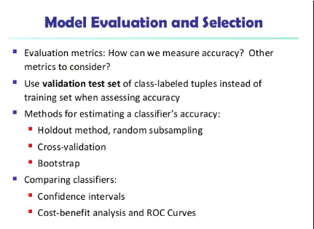
Model evaluation and selection

Slide 51
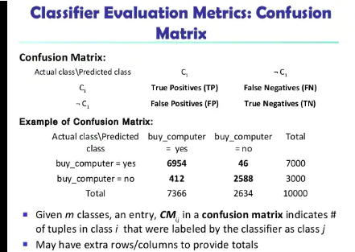

Slide 52
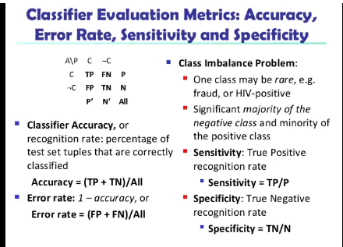

Slide 53
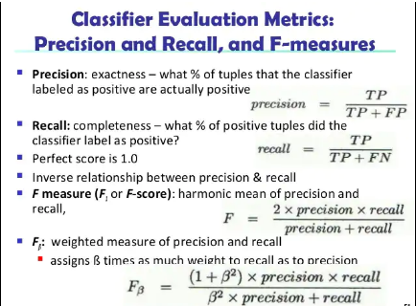

Slide 54
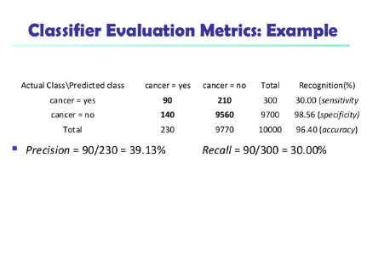

Slide 55
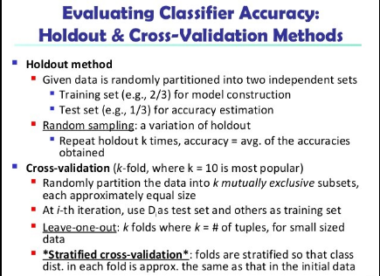

Slide 56
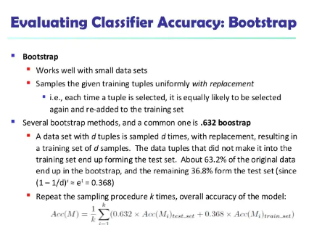

Slide 57
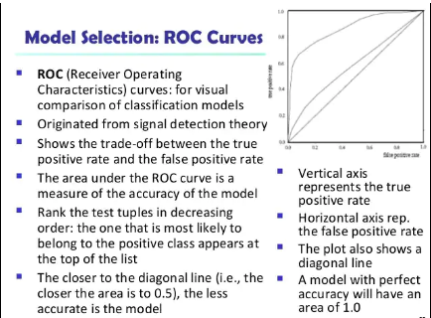

Slide 58
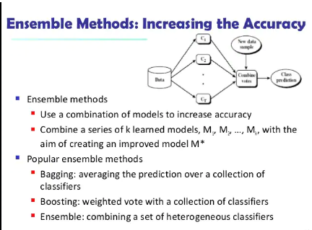
Techniques to improve classification accuracy

Slide 59
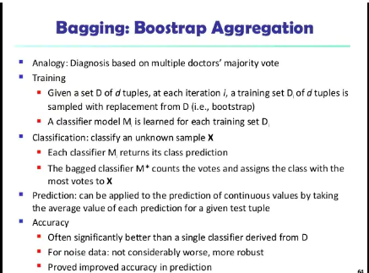

Slide 60
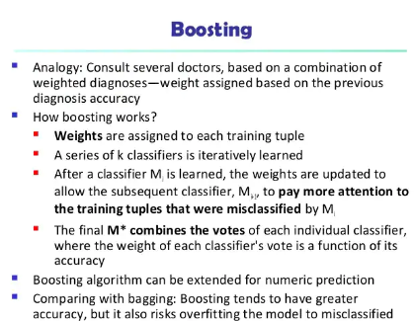

Slide 61
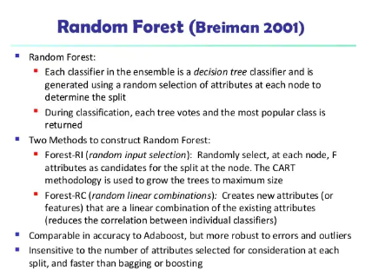

Slide 62
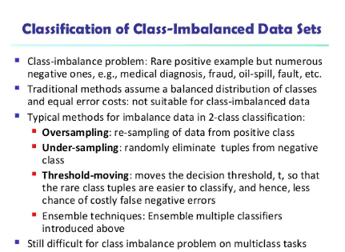

Slide 63
Support Vector Machines
Support Vector Machine or SVM is one of the most popular Supervised Learning algorithms, which is used for Classification as well as Regression problems. However, primarily, it is used for Classification problems in Machine Learning.
The goal of the SVM algorithm is to create the best line or decision boundary that can segregate n-dimensional space into classes so that we can easily put the new data point in the correct category in the future. This best decision boundary is called a hyperplane.
SVM chooses the extreme points/vectors that help in creating the hyperplane. These extreme cases are called as support vectors, and hence algorithm is termed as Support Vector Machine. Consider the below diagram in which there are two different categories that are classified using a decision boundary or hyperplane:

Slide 64


Slide 65
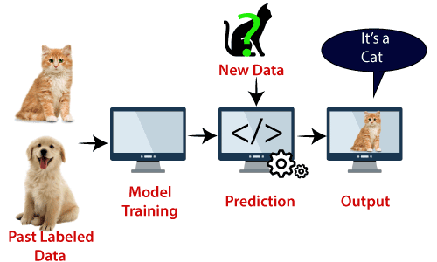
Example: SVM can be understood with the example that we have used in the KNN classifier. Suppose we see a strange cat that also has some features of dogs, so if we want a model that can accurately identify whether it is a cat or dog, so such a model can be created by using the SVM algorithm.
We will first train our model with lots of images of cats and dogs so that it can learn about different features of cats and dogs, and then we test it with this strange creature.
So as support vector creates a decision boundary between these two data (cat and dog) and choose extreme cases (support vectors), it will see the extreme case of cat and dog.
On the basis of the support vectors, it will classify it as a cat. Consider the below diagram:

Slide 66
SVM algorithm can be used for Face detection, image classification, text categorization, etc.
Types of SVM
SVM can be of two types:
Linear SVM: Linear SVM is used for linearly separable data, which means if a dataset can be classified into two classes by using a single straight line, then such data is termed as linearly separable data, and classifier is used called as Linear SVM classifier.
Non-linear SVM: Non-Linear SVM is used for non-linearly separated data, which means if a dataset cannot be classified by using a straight line, then such data is termed as non-linear data and classifier used is called as Non-linear SVM classifier.

Slide 67
Hyperplane and Support Vectors in the SVM algorithm:
Hyperplane: There can be multiple lines/decision boundaries to segregate the classes in n-dimensional space, but we need to find out the best decision boundary that helps to classify the data points. This best boundary is known as the hyperplane of SVM.
The dimensions of the hyperplane depend on the features present in the dataset, which means if there are 2 features (as shown in image), then hyperplane will be a straight line. And if there are 3 features, then hyperplane will be a 2-dimension plane.
We always create a hyperplane that has a maximum margin, which means the maximum distance between the data points.
Support Vectors:
The data points or vectors that are the closest to the hyperplane and which affect the position of the hyperplane are termed as Support Vector. Since these vectors support the hyperplane, hence called a Support vector.

Slide 68
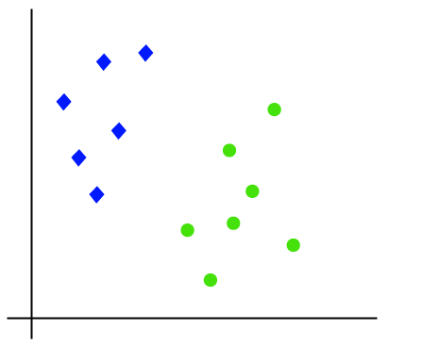
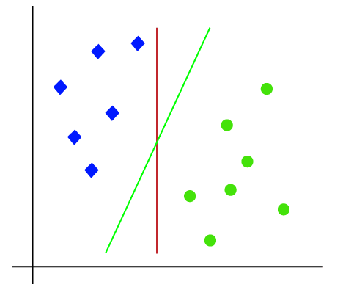
How does SVM works?
Linear SVM:The working of the SVM algorithm can be understood by using an example. Suppose we have a dataset that has two tags (green and blue), and the dataset has two features x1 and x2. We want a classifier that can classify the pair(x1, x2) of coordinates in either green or blue. Consider the below image:
So as it is 2-d space so by just using a straight line, we can easily separate these two classes. But there can be multiple lines that can separate these classes. Consider the below image:

Slide 69
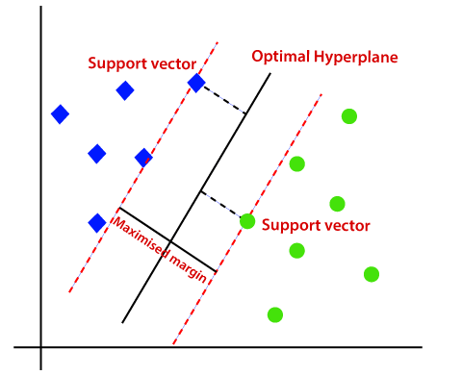
Hence, the SVM algorithm helps to find the best line or decision boundary; this best boundary or region is called as a hyperplane. SVM algorithm finds the closest point of the lines from both the classes. These points are called support vectors. The distance between the vectors and the hyperplane is called as margin. And the goal of SVM is to maximize this margin. The hyperplane with maximum margin is called the optimal hyperplane.

Slide 70
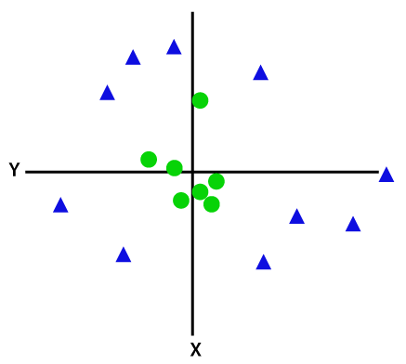
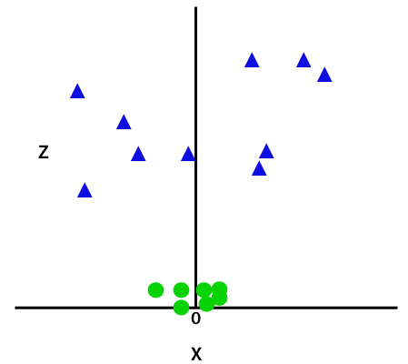
Non-Linear SVM:
If data is linearly arranged, then we can separate it by using a straight line, but for non-linear data, we cannot draw a single straight line. Consider the below image:
So to separate these data points, we need to add one more dimension. For linear data, we have used two dimensions x and y, so for non-linear data, we will add a third dimension z. It can be calculated as:
z=x² +y²
By adding the third dimension, the sample space will become as below image:

Slide 71
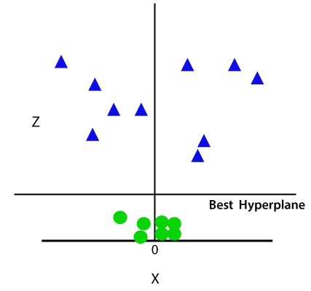
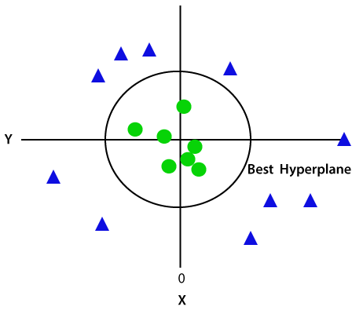
So now, SVM will divide the datasets into classes in the following way. Consider the below image:
Since we are in 3-d Space, hence it is looking like a plane parallel to the x-axis. If we convert it in 2d space with z=1, then it will become as:
Hence we get a circumference of radius 1 in case of non-linear data.

Slide 72
Classification using frequent patterns
Frequent patterns show interesting relationships between attribute–value pairs that occur frequently in a given data set.
For example, we may find that the attribute–value pairs age = youth and credit = OK occur in 20% of data tuples describing AllElectronics customers who buy a computer.
We can think of each attribute–value pair as an item, so the search for these frequent patterns is known as frequent pattern mining or frequent itemset mining
We already knew how association rules are derived from frequent patterns, where the associations are commonly used to analyze the purchasing patterns of customers in a store. Such analysis is useful in many decision-making processes such as product placement, catalog design, and cross-marketing
The general idea is that we can search for strong associations between frequent patterns (conjunctions of attribute–value pairs) and class labels.

Slide 73
In general, associative classification consists of the following steps:
1. Mine the data for frequent itemsets, that is, find commonly occurring attribute–value pairs in the data.
2. Analyze the frequent itemsets to generate association rules per class, which satisfy confidence and support criteria.
3. Organize the rules to form a rule-based classifier.
Methods of associative classification differ primarily in the approach used for frequent itemset mining and in how the derived rules are analyzed and used for classification.
CBA (Classification Based on Associations)
CMAR (Classification based on Multiple Association Rules)
CPAR (Classification based on Predictive Association Rules)

Slide 74
CBA (Classification Based on Associations).
CBA uses an iterative approach to frequent itemset mining, similar to that described for Apriori, where multiple passes are made over the data and the derived frequent itemsets are used to generate and test longer itemsets.
In general, the number of passes made is equal to the length of the longest rule found.
The complete set of rules satisfying minimum confidence and minimum support thresholds are found and then analyzed for inclusion in the classifier.
CBA uses a heuristic method to construct the classifier, where the rules are ordered according to decreasing precedence based on their confidence and support.
If a set of rules has the same antecedent, then the rule with the highest confidence is selected to represent the set.
When classifying a new tuple, the first rule satisfying the tuple is used to classify it.
The classifier also contains a default rule, having lowest precedence, which specifies a default class for any new tuple that is not satisfied by any other rule in the classifier.
In this way, the set of rules making up the classifier form a decision list. In general, CBA was empirically found to be more accurate than C4.5 on a good number of data sets.

Slide 75
CMAR (Classification based on Multiple Association Rules)
differs from CBA in its strategy for frequent itemset mining and its construction of the classifier.
It also employs several rule pruning strategies with the help of a tree structure for efficient storage and retrieval of rules.
CMAR adopts a variant of the FP-growth algorithm to find the complete set of rules satisfying the minimum confidence and minimum support thresholds.
FP-growth uses a tree structure, called an FP-tree, to register all the frequent itemset information contained in the given data set, D. This requires only two scans of D. The frequent itemsets are then mined from the FP-tree.
CMAR uses an enhanced FP-tree that maintains the distribution of class labels among tuples satisfying each frequent itemset. In this way, it is able to combine rule generation together with frequent itemset mining in a single step.

Slide 76
CMAR employs another tree structure to store and retrieve rules efficiently and to prune rules based on confidence, correlation, and database coverage. Rule pruning strategies are triggered whenever a rule is inserted into the tree.
For example, given two rules, R1 and R2, if the antecedent of R1 is more general than that of R2 and conf(R1) ≥ conf(R2), then R2 is pruned.
The rationale is that highly specialized rules with low confidence can be pruned if a more generalized version with higher confidence exists.
CMAR also prunes rules for which the rule antecedent and class are not positively correlated, based on an χ 2 test of statistical significance.

Slide 77
“If more than one rule applies, which one do we use?” As a classifier, CMAR operates differently than CBA.
Suppose that we are given a tuple X to classify and that only one rule satisfies or matches X.
This case is trivial—we simply assign the rule’s class label. Suppose, instead, that more than one rule satisfies X. These rules form a set, S. Which rule would we use to determine the class label of X? CBA would assign the class label of the most confident rule among the rule set, S.
CMAR instead considers multiple rules when making its class prediction. It divides the rules into groups according to class labels.
All rules within a group share the same class label and each group has a distinct class label.

Slide 78
CMAR uses a weighted χ 2 measure to find the “strongest” group of rules, based on the statistical correlation of rules within a group.
It then assigns X the class label of the strongest group. In this way it considers multiple rules, rather than a single rule with highest confidence, when predicting the class label of a new tuple.
In experiments, CMAR had slightly higher average accuracy in comparison with CBA. Its runtime, scalability, and use of memory were found to be more efficient.
“Is there a way to cut down on the number of rules generated?” CBA and CMAR adopt methods of frequent itemset mining to generate candidate association rules, which include all conjunctions of attribute–value pairs (items) satisfying minimum support.
These rules are then examined, and a subset is chosen to represent the classifier. However, such methods generate quite a large number of rules.

Slide 79
CPAR (Classification based on Predictive Association Rules)
takes a different approach to rule generation, based on a rule generation algorithm for classification known as FOIL First-Order Inductive Logic.
FOIL builds rules to distinguish positive tuples (e.g., buys computer = yes) from negative tuples (e.g., buys computer = no). For multiclass problems, FOIL is applied to each class.
That is, for a class, C, all tuples of class C are considered positive tuples, while the rest are considered negative tuples. Rules are generated to distinguish C tuples from all others.
Each time a rule is generated, the positive samples it satisfies (or covers) are removed until all the positive tuples in the data set are covered. In this way, fewer rules are generated.
CPAR relaxes this step by allowing the covered tuples to remain under consideration, but reducing their weight.

Slide 80
The process is repeated for each class. The resulting rules are merged to form the classifier rule set.
During classification, CPAR employs a somewhat different multiple rule strategy than CMAR. If more than one rule satisfies a new tuple, X, the rules are divided into groups according to class, similar to CMAR.
However, CPAR uses the best k rules of each group to predict the class label of X, based on expected accuracy.
By considering the best k rules rather than all of a group’s rules, it avoids the influence of lower-ranked

Slide 81
Other Classification Methods
These methods are less commonly used for classification in commercial data mining systems than the methods described earlier in this book. However, these methods show their strength in certain applications, and hence it is worthwhile to include them here.
Genetic Algorithms
Rough set Approach
Fuzzy set Approaches

Slide 82
Genetic algorithms
attempt to incorporate ideas of natural evolution. In general, genetic learning starts as follows.
An initial population is created consisting of randomly generated rules. Each rule can be represented by a string of bits.
As a simple example, suppose that samples in a given training set are described by two Boolean attributes, A1 and A2, and that there are two classes, C1 and C2. The rule “IF NOT A1 AND NOT A2 THEN C2” can be encoded as the bit string “100”, where the two leftmost bits represent attributes A1 and A2, respectively, and the rightmost bit represents the class, similarly, the rule “IF NOT A1 AND NOT A2 THEN C1” can be encoded as “001”.
If an attribute has k values, where k>2, then k bits may be used to encode the attribute’s values. Classes can be encoded in a similar fashion.

Slide 83
Based on the notion of survival of the fittest, a new population is formed to consist of the fittest rules in the current population, as well as offspring of these rules.
Typically, the fitness of a rule is assessed by its classification accuracy on asset of training samples.
Applying genetic operators such as crossover and mutation created offspring, in crossover, substrings from pairs of rules are swapped to form new pairs of rules, in mutation, randomly selected bits in a rule’s string are inverted.
The process of generating new populations based on prior populations of rules continues until a populations of rules continues until a population p “evolves” where each rule in P satisfies a prespecified fitness threshold.
Genetic algorithms are easily parallelizable and have been used for classification as well as other optimization problems, in data mining, they may be used to evaluate the fitness of other algorithms.

Slide 84
Rough set Approach
Rough set theory can be used for classification to discover structural relationships within imprecise or noisy data. It applies to discrete-valued attributes. Continuous-valued attributes must therefore be discretized prior to its use.
Rough set theory is based on the establishment of equivalence classes within the given training data. All of the data samples forming an equivalence class are indiscernible, that is, the samples are identical with respect to the attributes describing the data.
Given real-world data, it is common that some classes cannot be distinguished in terms of the available attributes.
Rough sets can be used to approximately or “roughly” define such classes. A rough set definition for a given class c is approximated by two sets-a lower approximation of C and an upper approximation of C. the lower approximation of C consists of all of the data samples that, based on the knowledge of the attributes, ate certain to belong to C without ambiguity.
The upper approximation of C consists of all of the samples that, based on the knowledge of the attributes, cannot be described as not belonging to C. decision rules can be generated for each class. Typically, a decision table is used to represent the rules.

Slide 85
Rough sets can also be used for feature reduction (where attributes that do not contribute towards the classification of the given training data can be identified and removed) and relevance analysis (where the contribution or significance of each attribute is assessed with respect to the classification task).
The problem of finding the minimal subsets (reducts) of attributes that can describe all of the concepts in the given data set is NP-hard.
However, algorithms to reduce the computation intensity have been proposed. In one method, for example, discernibility matrix is used that stores the differences between attribute values for each pair of data samples. Rather than searching on the entire training set, the matrix is instead searched to detect redundant attributes.

Slide 86
Fuzzy set Approaches
Rule-based systems for classification have the disadvantage that they involve sharp cutoffs for continuous attributes. For example, consider the following rule for customer credit application approval.
The rule essentially says that applications for customers who have dad a job for two or more years and who have a high income (i.e., of at least $50k) ate approved:
IF (years_employed) >=2^(income>50k) THEN credit=”approved”
A customer who has had a job for at least two years will receive credit if her income is, say, $50k, but not id it is $49k.
Such harsh thresholding may seem unfair. Instead, fuzzy logic can be introduced into the system to allow “fuzzy” thresholds or boundaries to be defined. Rather than having a precise cutoff between categories or sets, fuzzy logic uses truth-values between 0.0 and 1.0 to represent the degree of membership that a certain value has in a given category. Hence, with fuzzy logic, we can capture the notion that an income of $49k is, to some degree, high, although not as high as an income of $50k.

Slide 87
Fuzzy logic is useful for data mining systems performing classification. It provides the advantage of working at a high level of abstraction. In general, the use of fuzzy logic in rule-based systems involves the following:
• Attribute values are converted to fuzzy values. The fuzzy membership or truth values are calculated- Fuzzy logic systems typically provide graphical tools to assist users in this step.
• For a given new sample, more than one fuzzy rule may apply. Each applicable rule contributes a vote for membership in the categories. Typically, the truth-values for each predicted category are summed.
• The sums obtained above ate combined into a value that is returned by the system. Weighting each category by its truth sum and multiplying by the mean truth-value of each category may do this process, the calculations involved may be more complex, depending on the complexity of the fuzzy membership graphs.
Fuzzy logic systems have been used in numerous areas for classification, including health care and finance.

Slide 88
End of Unit IV

